Slide 1
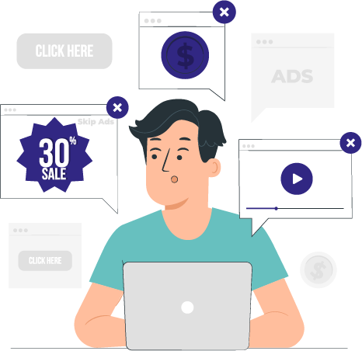
Reach your target consumers through our app
Launching Q1’2024

Slide 2
Working with FlyPool
Flexibility
we can accept various ad formats, like text, image, video and HTML5 ads
Detailed reporting
you will get detailed reports on the ads performance
quick turnaround time
you ad will be live within 5 working days
Targeted advertising
your ad will be targeted to the people who are in close proximity to your business

Slide 3
FlyPool Audience
FlyPool is used by people who travel to and from airports, including but not limited to:
Business and leisure travelers
People picking up/dropping off their relatives & friends
Airlines stuff
Airport stuff

Slide 4
Details and benefits of our offers
What's included
Strategic placement of your ads on the FlyStore, with maximum visibility to captivate our audience.
Ability to display banner ads, sponsored ads, pop-ups, and other customized formats to match your marketing objectives.
Advanced targeting tools to reach your ideal audience based on demographic, geographic and behavioral criteria.
Personalize your advertising message to highlight special offers, promotions, upcoming events and other relevant content.
Detailed reporting on campaign performance, including data on impressions, clicks, conversions and ROI.

Slide 5
Details and benefits of our offers
Advantages
Increased visibility among a highly qualified audience of travelers, explorers and adventure enthusiasts.
Opportunity to strengthen your market position and stand out from your competitors thanks to a presence on an internationally renowned platform.
Flexibility in managing your advertising campaign, with the ability to adjust your ads in real time to optimize results.
Dedicated support from our marketing team to advise and accompany you throughout your campaign.
Commit to the required 03 months to benefit from preferential rates.

Slide 6
Price list for directly sold advertising spaces on FlyPool apps
FLYPREMIUM
Best offer!
$120/month
$4/day
FLYPRO
FLYSTARTER
$80/month
$2⁶⁶/day
$99/month
$3³⁰/day
Showcasing your products and services on the FlyStore
Strategic placement of your ads on the Flypool app
06 display banner ads, sponsored ads, pop-ups, etc.
Personalize your advertising message
Advanced targeting tools to reach your ideal audience
Detailed reporting on campaign performance
Showcasing your products and services on the FlyStore
Strategic placement of your ads on the Flypool app
05 display banner ads, sponsored ads, pop-ups, etc.
Personalize your advertising message
Showcasing your products and services on the FlyStore
Strategic placement of your ads on the Flypool app
03 display banner ads, sponsored ads, pop-ups, etc.

Slide 7
Save 20% by taking out a 03 month offer!
FLYPREMIUM
Best offer!
$288 $360 for 03 month
FLYPRO
FLYSTARTER
20% of Discount
$237⁶⁰ $297 for 03 month
$192 $240 for 03 month
Showcasing your products and services on the FlyStore
Strategic placement of your ads on the Flypool app
06 display banner ads, sponsored ads, pop-ups, etc.
Personalize your advertising message
Advanced targeting tools to reach your ideal audience
Detailed reporting on campaign performance
20% of Discount
20% of Discount
Showcasing your products and services on the FlyStore
Strategic placement of your ads on the Flypool app
05 display banner ads, sponsored ads, pop-ups, etc.
Personalize your advertising message
Showcasing your products and services on the FlyStore
Strategic placement of your ads on the Flypool app
03 display banner ads, sponsored ads, pop-ups, etc.

Slide 8
Next steps
01
Pick a format and bid type and book the inventory it with your sales manager
02
Share your ad creative with us (through your sales manager), please follow our guidelines for ad creatives;
03
Your sales manager will give you instructions on how to pay for the advertisement
04
Expect your ad to be live within 5 working days

Slide 9
Additional services
Designing ad creative in house
Standard text app banner ad creative (incl. Collapsible format) | No iterations permitted | Complimentary | You must provide the text
Standard display app banner ad creative (incl. Collapsible format) | 2 iterations permitted | 90 USD (complimentary with purchase over 100,000 impressions/month) | You must provide us with your logo; text of the ad; colours specifications
Full screen display app banner (interstitial) | 2 iterations permitted | 120 USD (complimentary with purchase over 100,000 impressions/month) | You must provide us with your logo; text of the ad; colours specifications; any images you want to use

Slide 10
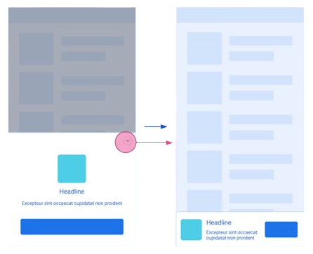
Available ad formats on FlyPool app (iOS; Android)
Collapsible adaptive banner
Anchor adaptive banner
Interstitial (fullscreen) banner
Also available: Native ad banners, designed to promote your mobile app and drive installs; App Open banners (75% of the initial app screen)

Slide 11
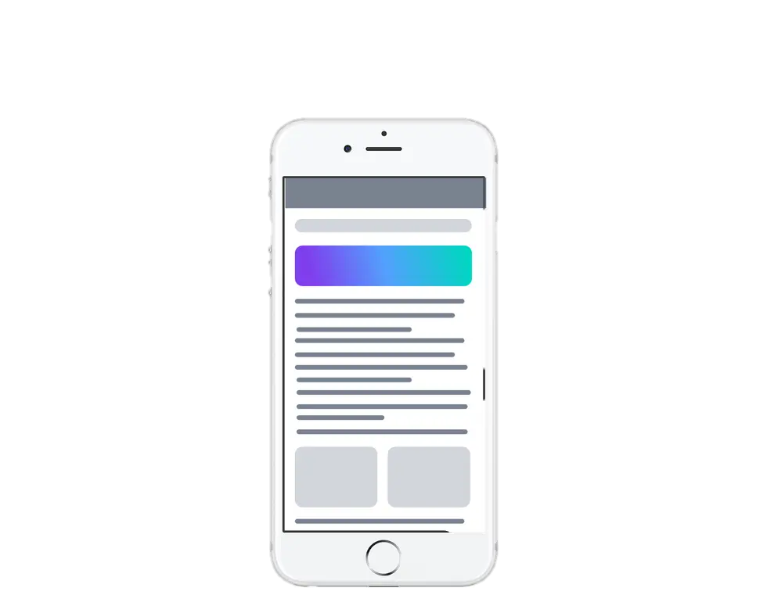
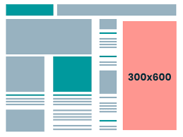
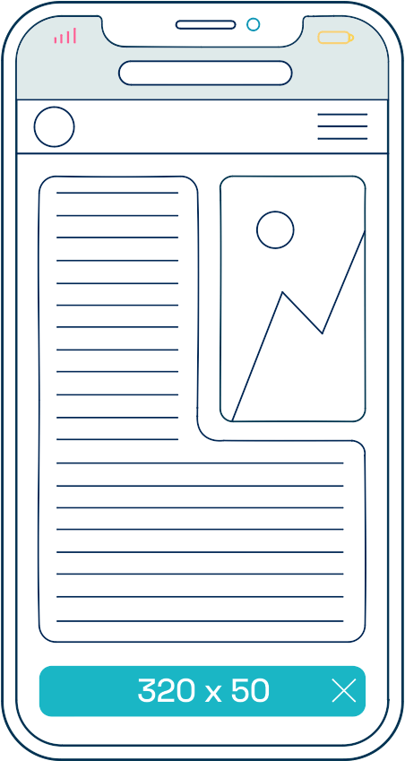
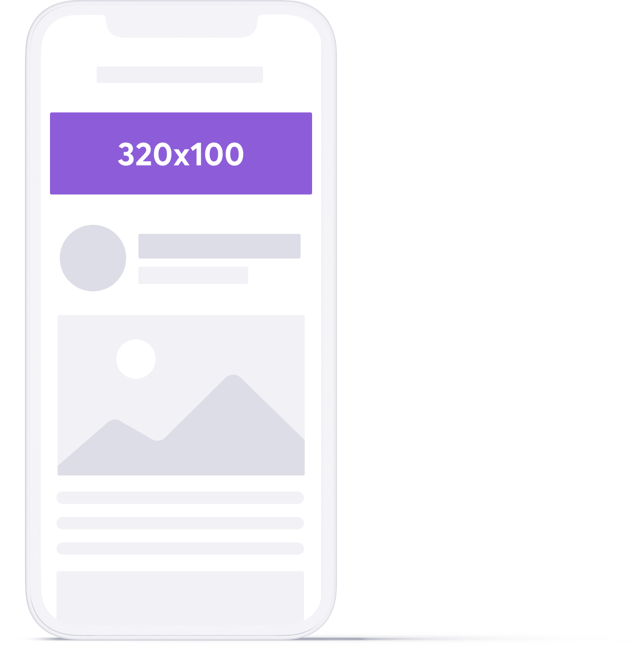
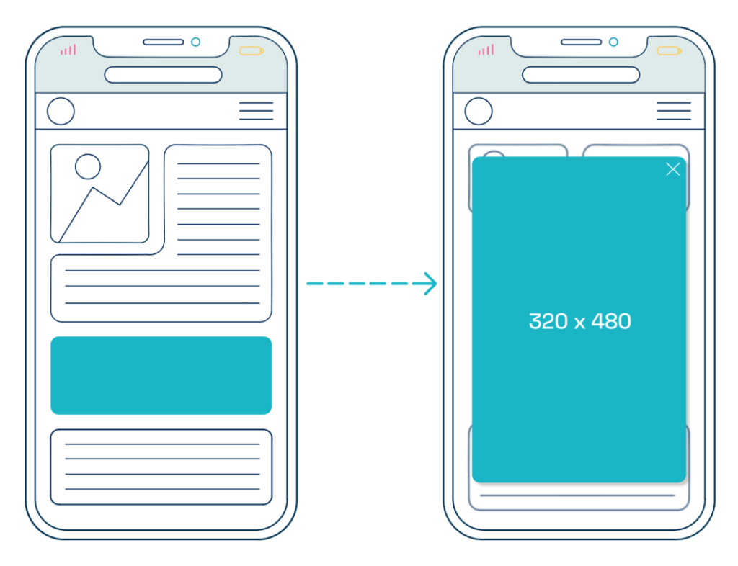
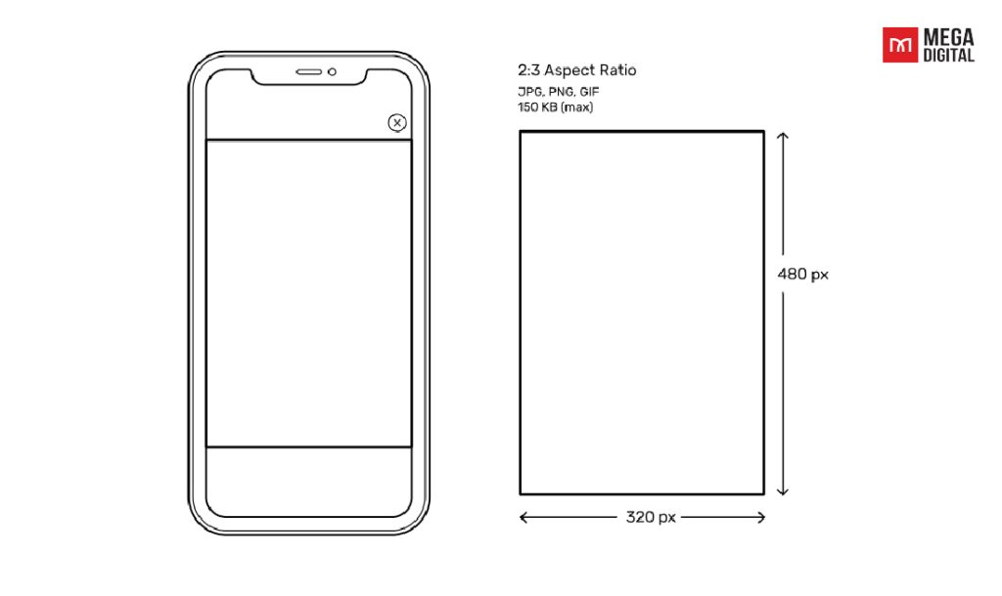
Advertising format sizes available :
300x600 banner / on the store
320 x 50: Mobile leaderboard
480 x 32: Mobile banner (landscape)
320 x 100: Large mobile banner
320 x 480: Smartphone interstitial (portrait)
480 x 320: Smartphone interstitial (landscape)

Slide 12
Thank you!

